Slide 1
TIBCO Spotfire Overview

Slide 2
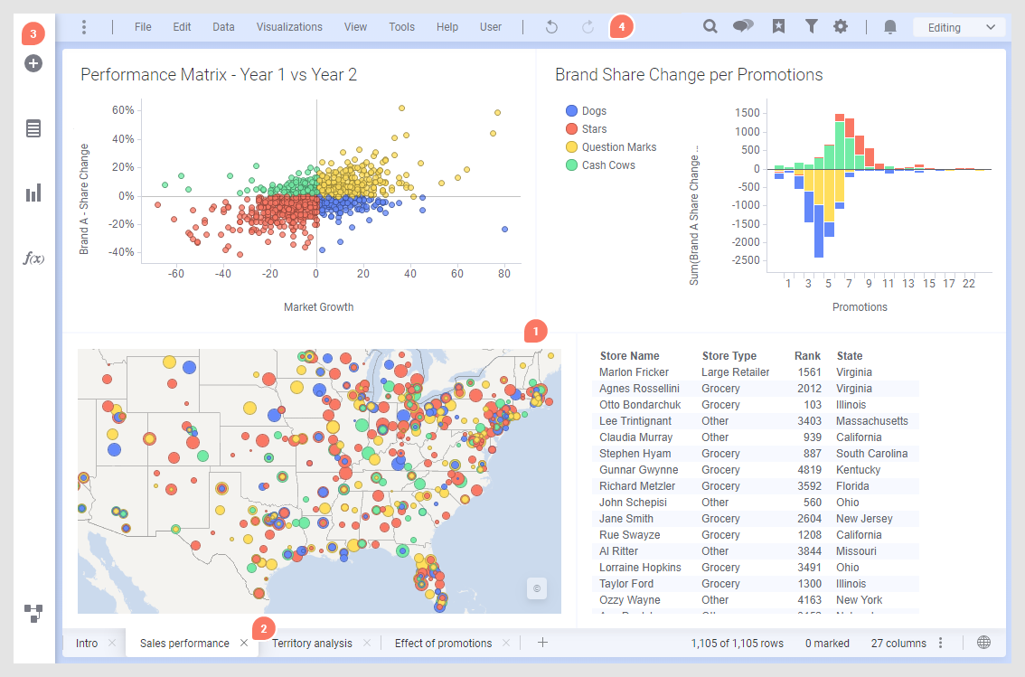
User Interface
Visualization
Pages
Authoring Bar
Menu Bar

Slide 3
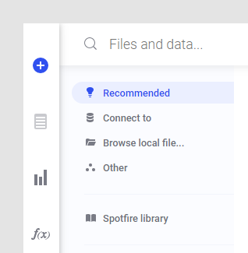
Load your Data
You can load data into the internal data engine of TIBCO Spotfire (in-memory analysis) from a number of different sources:
by pasting data from the clipboard,
by dragging and dropping or opening simple text files, Microsoft Excel files or SAS files (or additional file sources if such have been configured by your company),
by importing data from a database or other data source using data connections,
from an information link (a predefined connection to a shared data source),
from a data function designed to load data,
or, by connecting to a database via ODBC or OLE DB.
TIBCO Spotfire also supports in-database (in-db) connections to external data sources, such as Microsoft SQL Server Analysis Services, Oracle, Teradata, TIBCO Spotfire Data Streams, etc. When a connection to an external source is set up with in-db data tables, all calculations are done by the external data source and not by Spotfire.

Slide 4
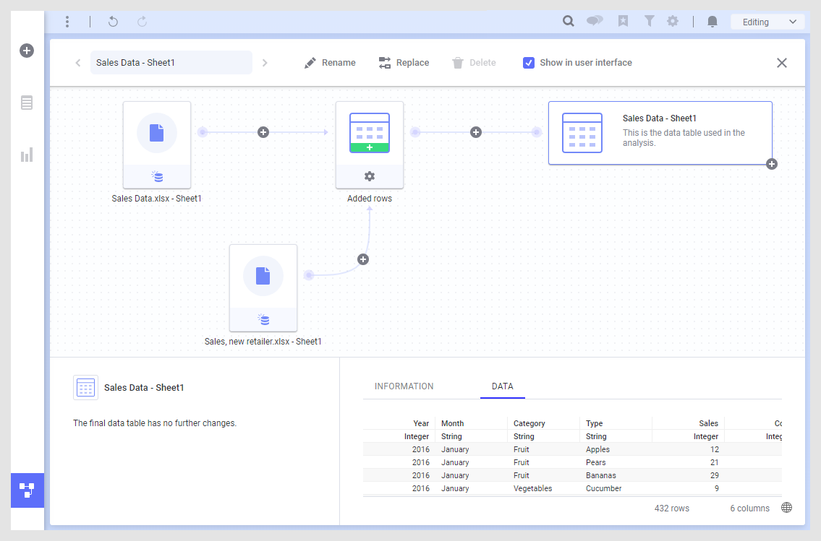
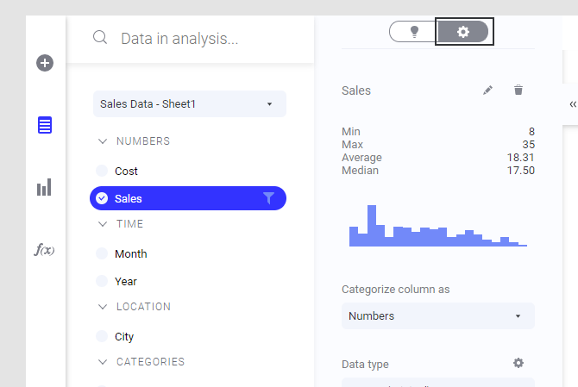
Know the Data

Slide 5
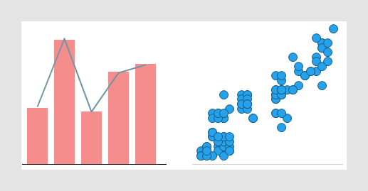
Visualize Data
There are three ways to create visualizations:
Start from the data.
Start from a visualization type.
Search for what you want to visualize.

Slide 6
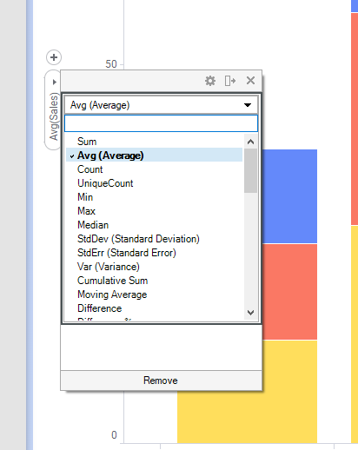
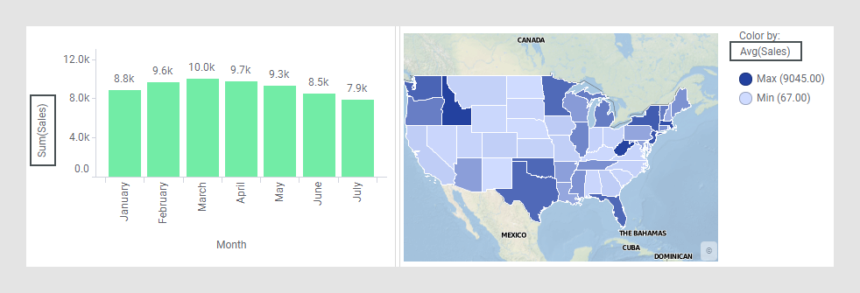
Analyze Data – Summarizing

Slide 7
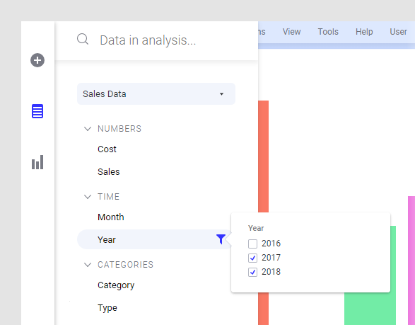
Analyze Data – Filtering

Slide 8
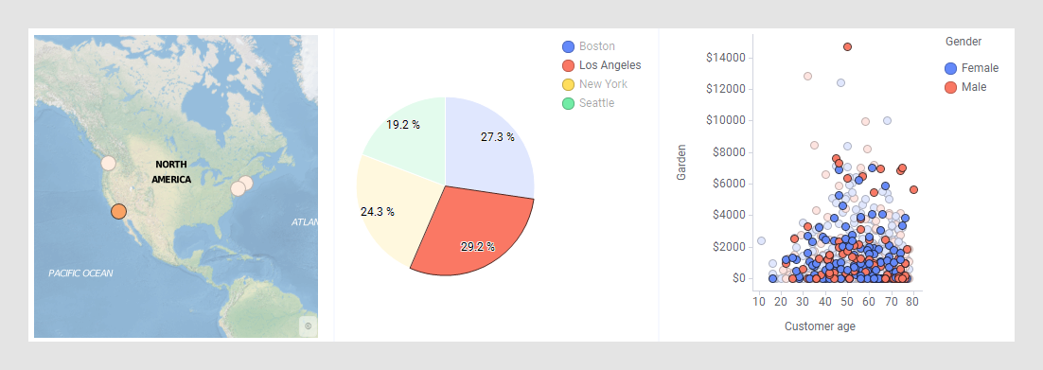
Analyze Data – Details

Slide 9
Exercise
Load the injuries.csv file from the NEISS data set.
Create three different visualizations showing number of injuries by age, sex and race.

